Slide 1
St. Louis Central Corridor West Building Permits
Monthly Report: January 2022

Slide 2
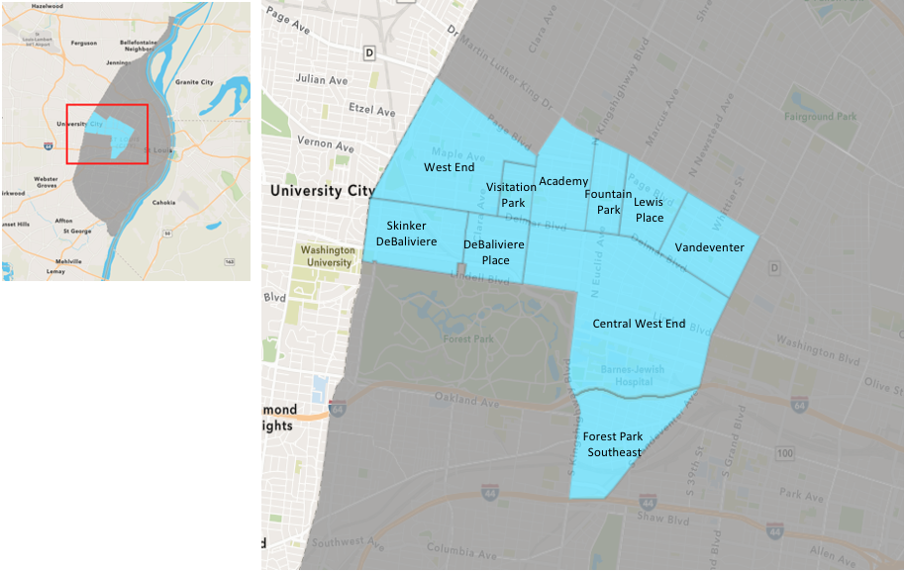
St. Louis Neighborhood Spatial Reference

Slide 3
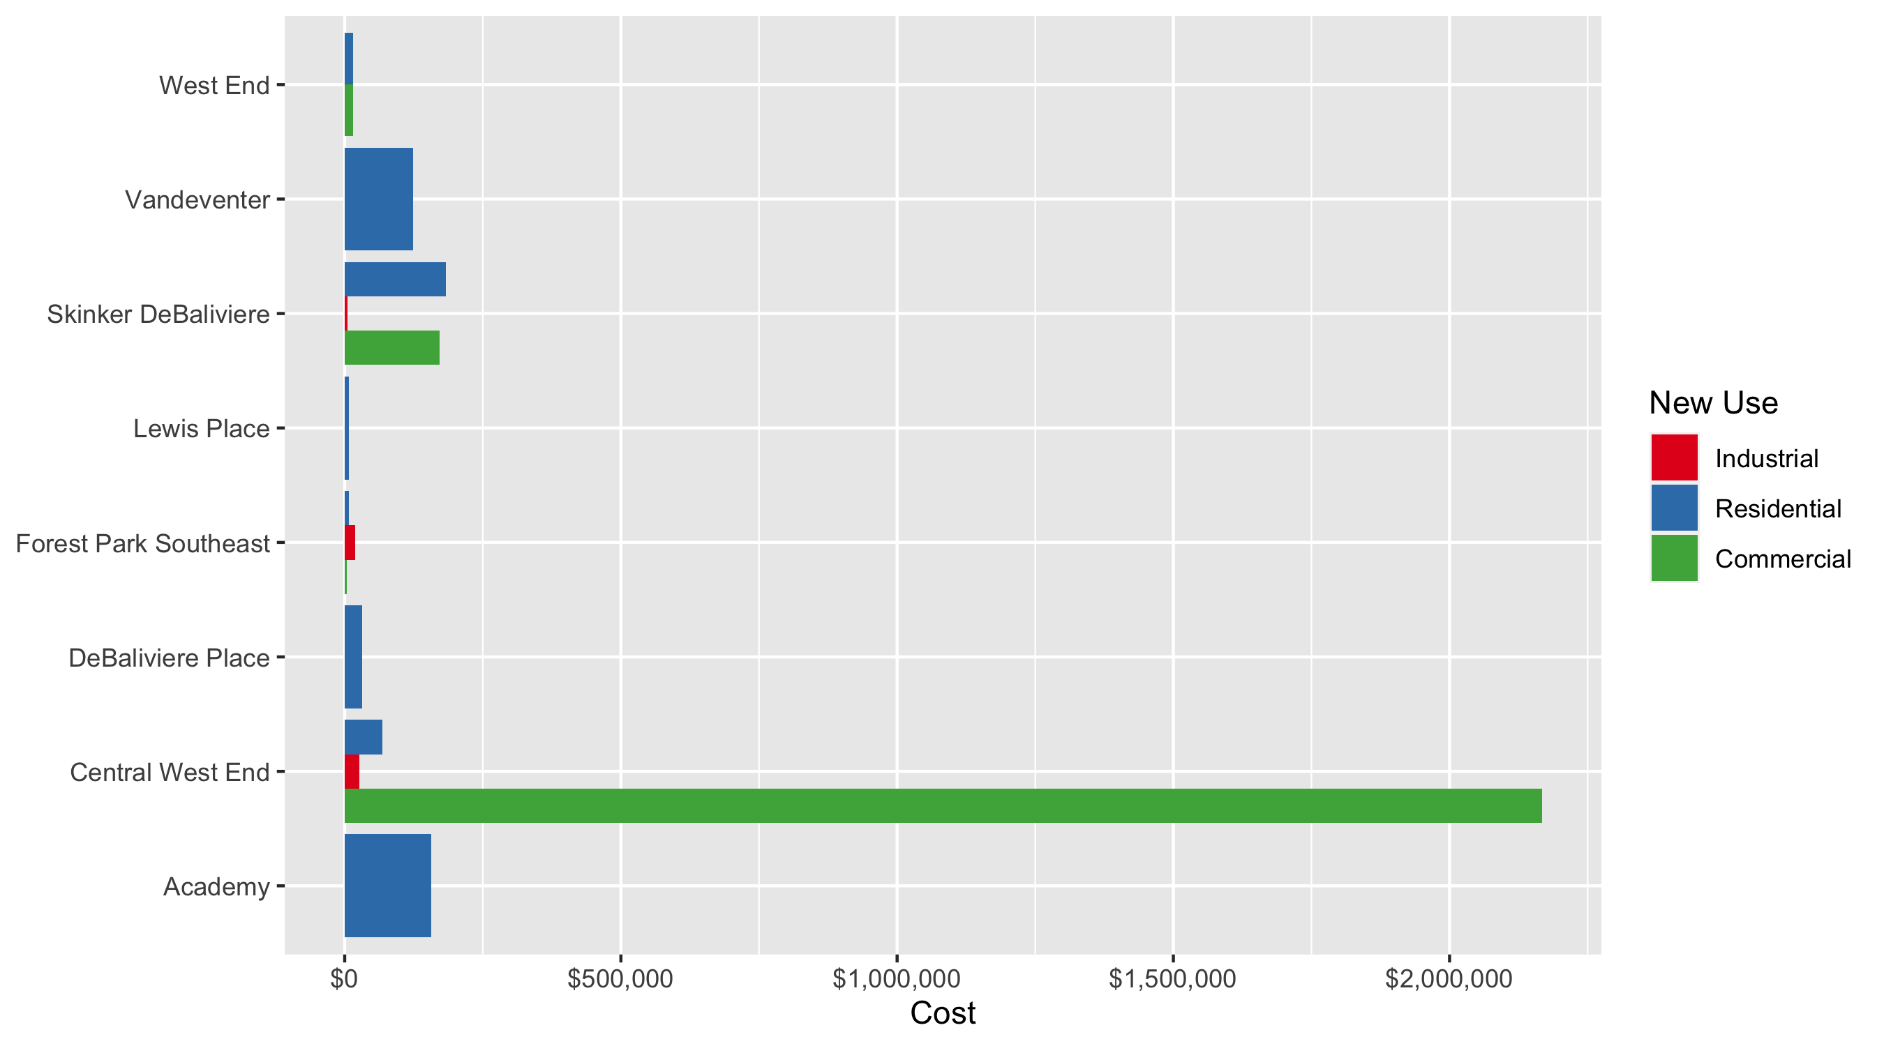
Neighborhood Summary: Average Building Permit Cost

Slide 4
Neighborhood Summary
January 2022 | January 2022 | January 2022 | January 2022
Neighborhood | Average Cost | # of Permits | Total Value of Permits
Academy | $157,100.00 | 2 | $314,200
Central West End | $1,378,558.50 | 32 | $44,113,872
DeBaliviere Place | $32,144.50 | 2 | $64,289
Forest Park Southeast | $7,389.90 | 10 | $73,899
Fountain Park | $0.00 | 0 | $0
Lewis Place | $7,500.00 | 1 | $7,500
Skinker DeBaliviere | $149,521.17 | 6 | $897,127
Vandeventer | $124,000.00 | 1 | $124,000
Visitation Park | $0.00 | 0 | $0
West End | $14,985.57 | 7 | $104,899
Last 6 Months | Last 6 Months | Last 6 Months | Last 6 Months
Neighborhood | Average Cost | # of Permits | Total Value of Permits
Academy | $43,971.85 | 26 | $1,143,268
Central West End | $743,207.56 | 237 | $176,140,191
DeBaliviere Place | $94,044.50 | 26 | $2,445,157
Forest Park Southeast | $41,065.96 | 100 | $4,106,596
Fountain Park | $345,493.00 | 9 | $3,109,437
Lewis Place | $95,582.40 | 15 | $1,433,736
Skinker DeBaliviere | $155,004.21 | 48 | $7,440,202
Vandeventer | $98,449.87 | 15 | $1,476,748
Visitation Park | $42,475.00 | 4 | $169,900
West End | $32,844.35 | 82 | $2,693,237

Slide 5
Core Neighborhoods

Slide 6
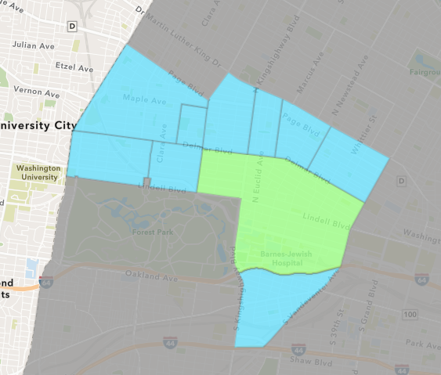
Central West End
January 2022 Neighborhood Cost Breakdown
Mean: $1,378,558
Median: $52,000
Range: $3,000 - $40,000,000

Slide 7
Central West End: Summary Notes
32 building permits in January 2022
-15.79% change compared to January 2021 (38 total building permits)
$1,378,558: Average building permit cost in January 2022
2231.59% change compared to January 2021 ($59,125)
32 total building permits in 2022
-15.79% change YTD compared to this time in 2021 (38 total building permits)
$1,378,558: YTD average building permit cost in 2022
2231.59% change YTD compared to this time in 2021 ($59,125)

Slide 8
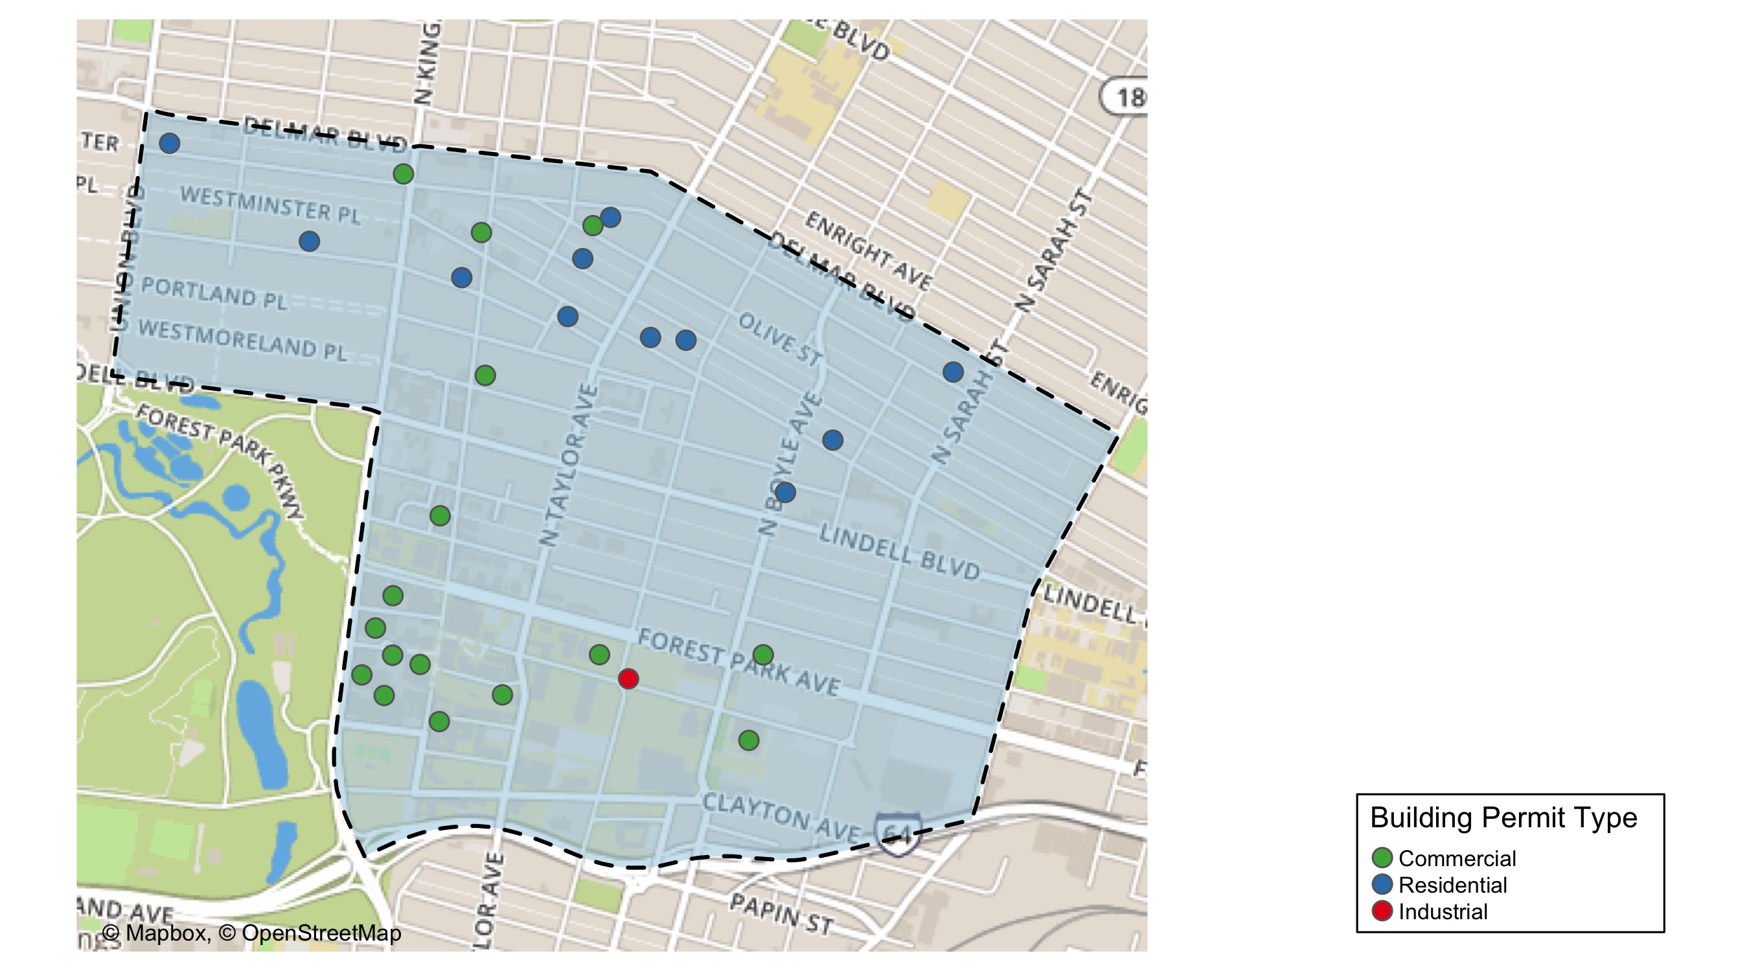
Central West End

Slide 9
Neighborhood Summary
January 2022 | January 2022 | January 2022 | January 2022
Permit Use | Average Cost | # of Permits | Total Value of Permits
Commercial | $2,167,018.25 | 20 | $43,340,365
Industrial | $26,000.00 | 1 | $26,000
Residential | $67,955.18 | 11 | $747,507
Last 6 Months | Last 6 Months | Last 6 Months | Last 6 Months
Permit Use | Average Cost | # of Permits | Total Value of Permits
Commercial | $1,737,171.5 | 92 | $159,819,781
Industrial | $57,350.0 | 12 | $688,200
Residential | $117,535.4 | 133 | $15,632,210

Slide 10
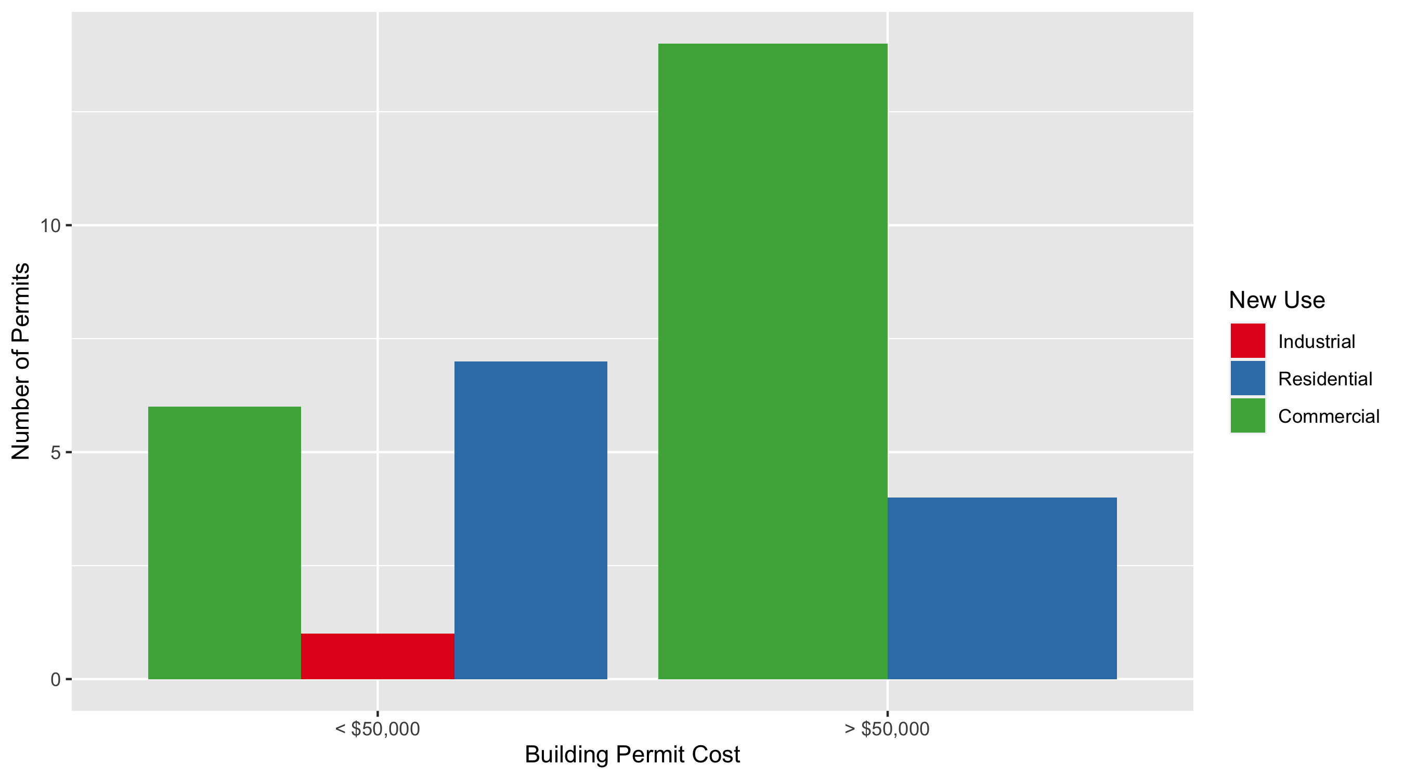
Central West End Permit Cost Breakdown

Slide 11
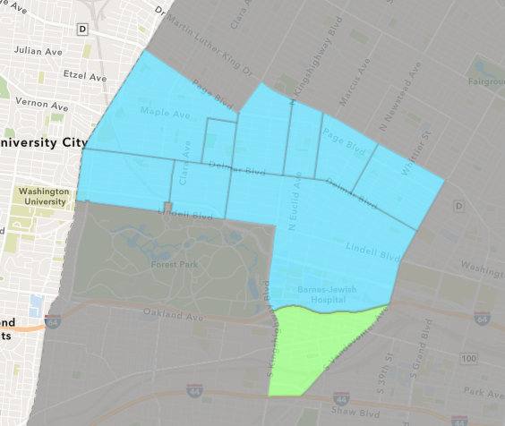
Forest Park Southeast
January 2022 Neighborhood Cost Breakdown
Mean: $7,390
Median: $5,250
Range: $1,000 - $25,000

Slide 12
Forest Park Southeast: Summary Notes
10 building permits in January 2022
25.00% change compared to January 2021 (8 total building permits)
$7,390: Average building permit cost in January 2022
-90.58% change compared to January 2021 ($78,462)
10 total building permits in 2022
25.00% change YTD compared to this time in 2021 (8 total building permits)
$7,390: YTD average building permit cost in 2022
-90.58% change YTD compared to this time in 2021 ($78,462)

Slide 13
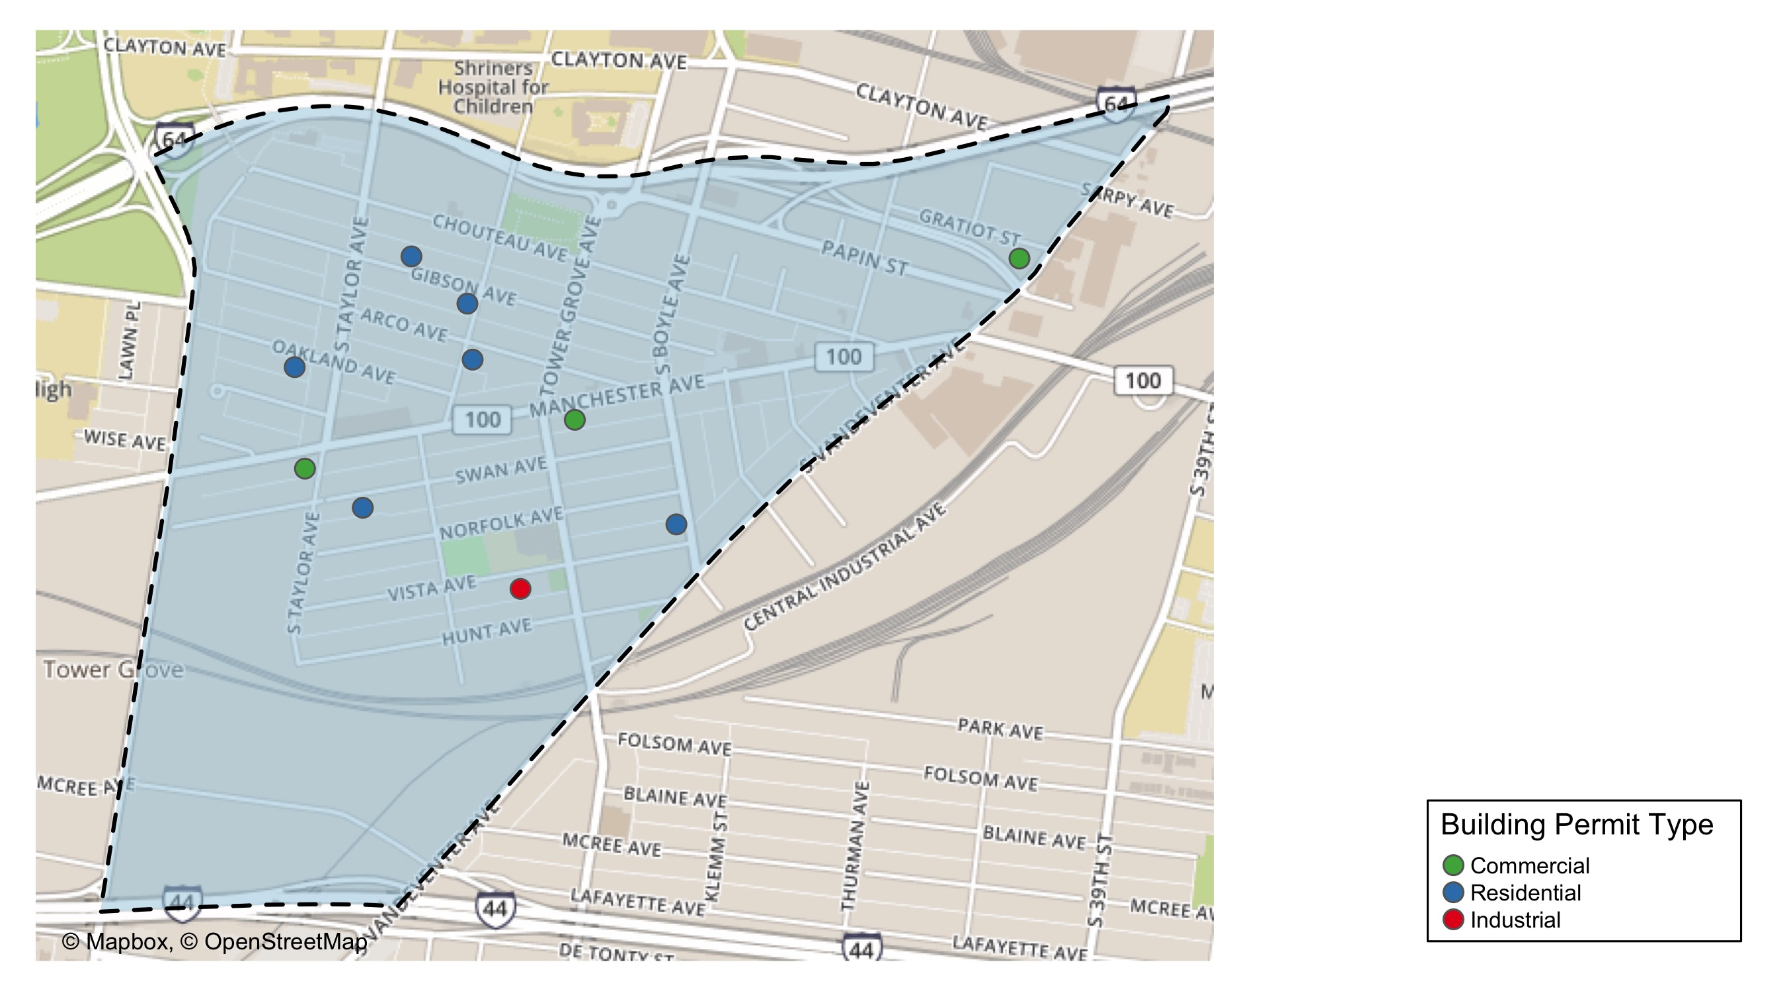
Forest Park Southeast

Slide 14
Neighborhood Summary
January 2022 | January 2022 | January 2022 | January 2022
Permit Use | Average Cost | # of Permits | Total Value of Permits
Commercial | $3,999.667 | 3 | $11,999
Industrial | $18,900.000 | 1 | $18,900
Residential | $7,166.667 | 6 | $43,000
Last 6 Months | Last 6 Months | Last 6 Months | Last 6 Months
Permit Use | Average Cost | # of Permits | Total Value of Permits
Commercial | $46,447.80 | 20 | $928,956
Industrial | $10,015.00 | 6 | $60,090
Residential | $42,129.05 | 74 | $3,117,550

Slide 15
Forest Park Southeast Individual Permit Breakdown
Neighborhood | Owner | New Use | Cost | address
Forest Park Southeast | CENCORE CAPITAL LLC | Industrial | $18,900 | 4328 VISTA AV
Forest Park Southeast | AJC REALTY PARTNERS LLC | Residential | $2,000 | 1313 S BOYLE AV
Forest Park Southeast | GROVE PLACE II LP | Commercial | $1,499 | 4510 MANCHESTER AV
Forest Park Southeast | HOUSEMAN ZOTOS 4522 4524 OAKLAND LLC | Residential | $1,000 | 4522-24 OAKLAND AV
Forest Park Southeast | 4256 MANCHESTER LLC | Commercial | $6,000 | 4256 MANCHESTER AV
Forest Park Southeast | PARK EAST II LP | Residential | $6,000 | 4445-47 GIBSON AV
Forest Park Southeast | SERIES PROP 1A OF HFC PROPERTIES LLC | Residential | $8,000 | 4438 SWAN AV
Forest Park Southeast | UAP-SLRC LLC | Commercial | $4,500 | 805 S VANDEVENTER AV
Forest Park Southeast | MATTHEW VINCENT & BONNIE SCHROEDER | Residential | $25,000 | 4346 ARCO AV
Forest Park Southeast | PARK EAST II LP | Residential | $1,000 | 4402 GIBSON AV

Slide 16
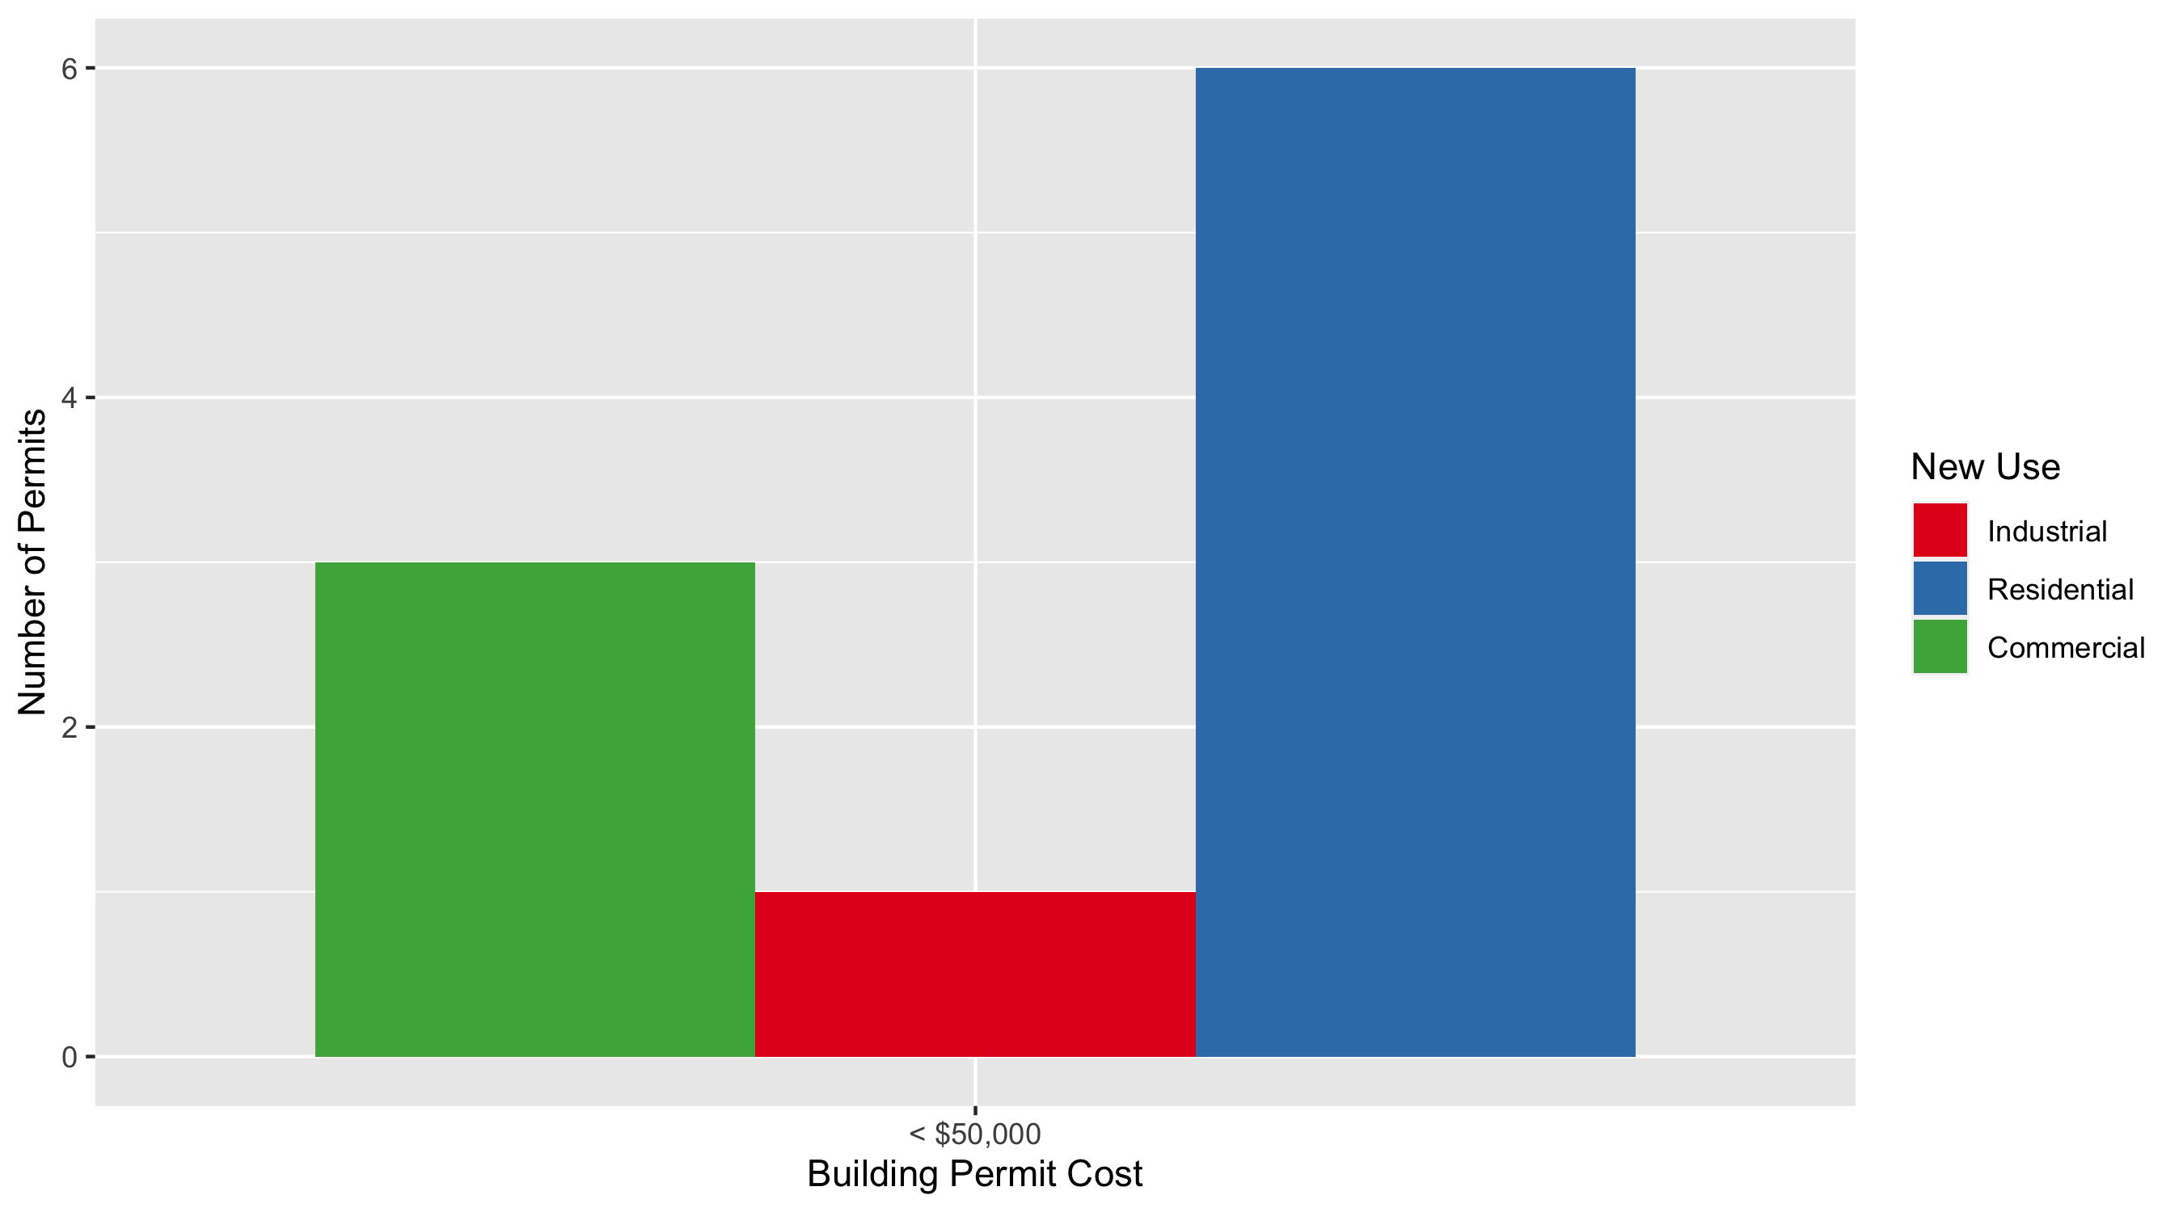
Forest Park Southeast Permit Cost Breakdown

Slide 17
Expanded Service Area

Slide 18
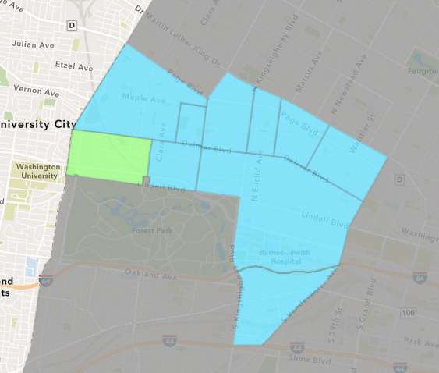
Skinker DeBaliviere
January 2022 Neighborhood Cost Breakdown
Mean: $149,521
Median: $141,421
Range: $4,500 - $329,683

Slide 19
Skinker DeBaliviere: Summary Notes
6 building permits in January 2022
-25.00% change compared to January 2021 (8 total building permits)
$149,521: Average building permit cost in January 2022
255.69% change compared to January 2021 ($42,037)
6 total building permits in 2022
-25.00% change YTD compared to this time in 2021 (8 total building permits)
$149,521: YTD average building permit cost in 2022
255.69% change YTD compared to this time in 2021 ($42,037)

Slide 20
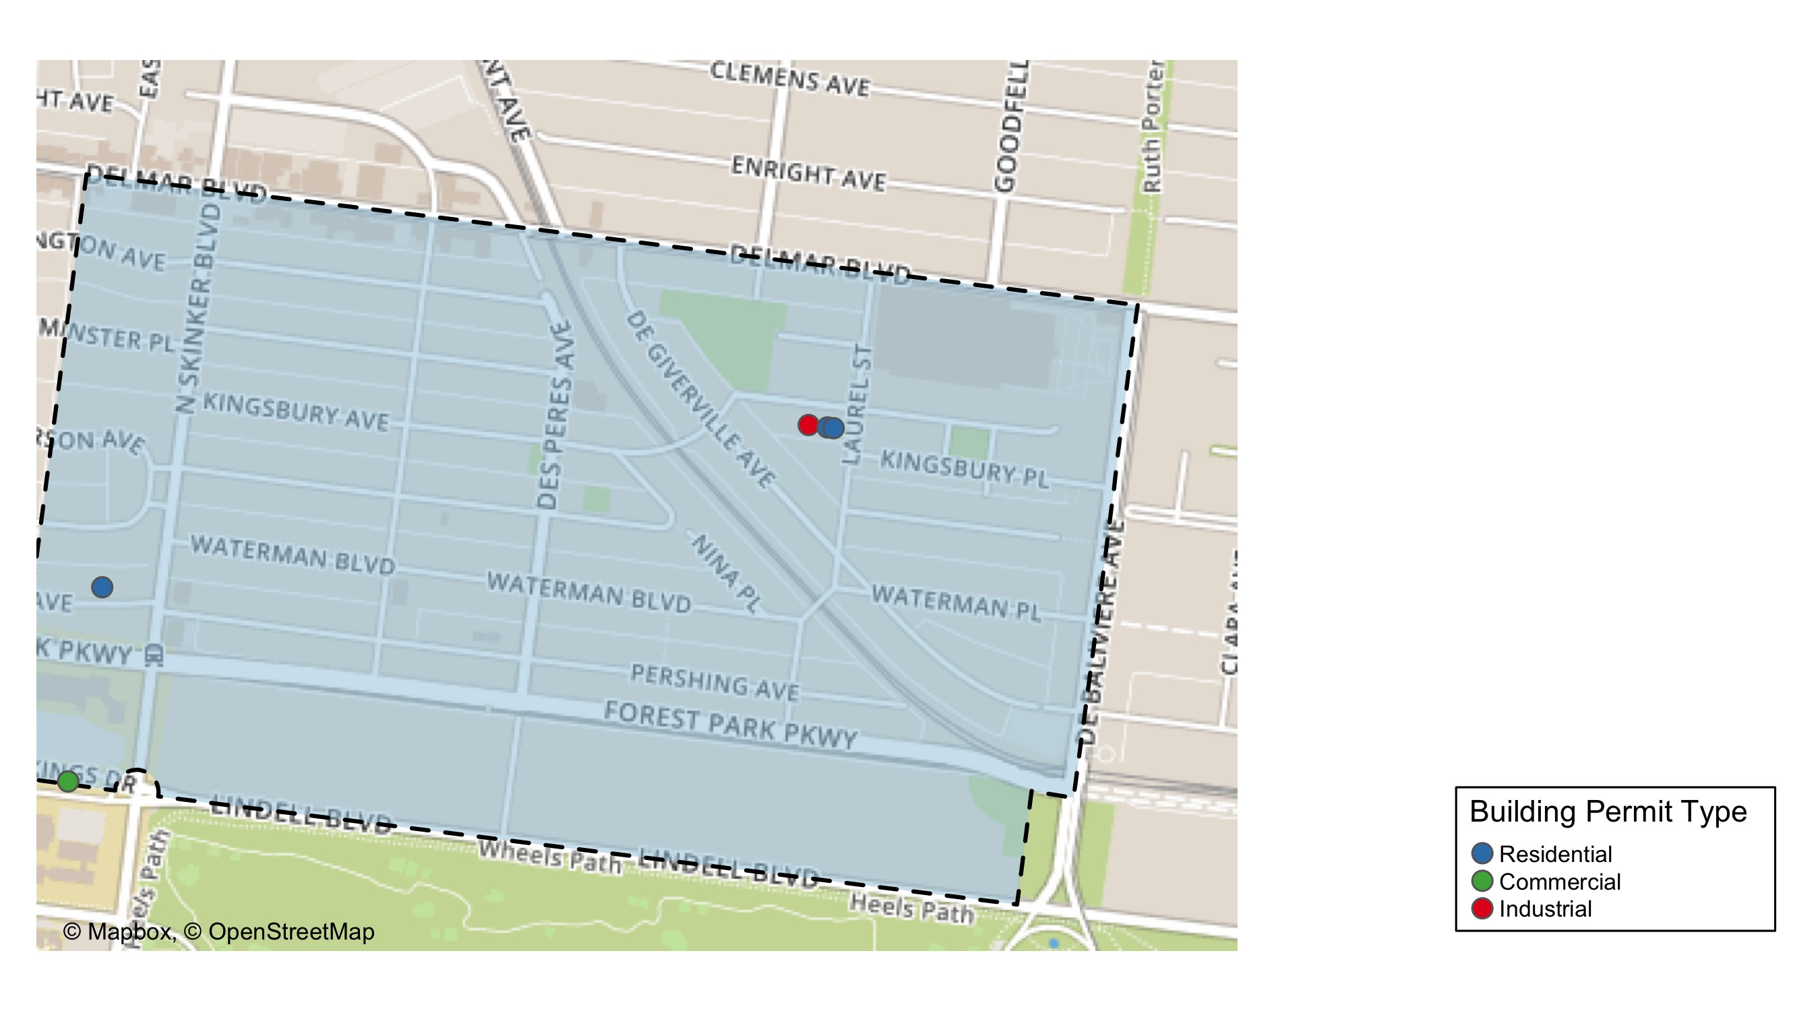
Skinker DeBaliviere

Slide 21
Neighborhood Summary
January 2022 | January 2022 | January 2022 | January 2022
Permit Use | Average Cost | # of Permits | Total Value of Permits
Commercial | $171,262.5 | 2 | $342,525
Industrial | $4,500.0 | 1 | $4,500
Residential | $183,367.3 | 3 | $550,102
Last 6 Months | Last 6 Months | Last 6 Months | Last 6 Months
Permit Use | Average Cost | # of Permits | Total Value of Permits
Commercial | $54,496.43 | 7 | $381,475
Industrial | $27,100.00 | 5 | $135,500
Residential | $192,311.86 | 36 | $6,923,227

Slide 22
Skinker DeBaliviere Individual Permit Breakdown
Neighborhood | Owner | New Use | Cost | address
Skinker DeBaliviere | PATON REDEVELOPMENT SERIES LLC | Residential | $270,000 | 5806 WESTMINSTER PL
Skinker DeBaliviere | PATON REDEVELOPMENT SERIES LLC | Residential | $270,000 | 5808 WESTMINSTER PL
Skinker DeBaliviere | WASHINGTON UNIVERSITY ART BUILDING | Commercial | $329,683 | 6200 FOREST PARK PARKWAY
Skinker DeBaliviere | BONDS, RONALD | Industrial | $4,500 | 5818 WESTMINSTER PL
Skinker DeBaliviere | FOWLER, FLINT W & JUNE | Residential | $10,102 | 6225 PERSHING AV
Skinker DeBaliviere | WASHINGTON UNIVERSITY ART BUILDING | Commercial | $12,842 | 6200 FOREST PARK PARKWAY

Slide 23
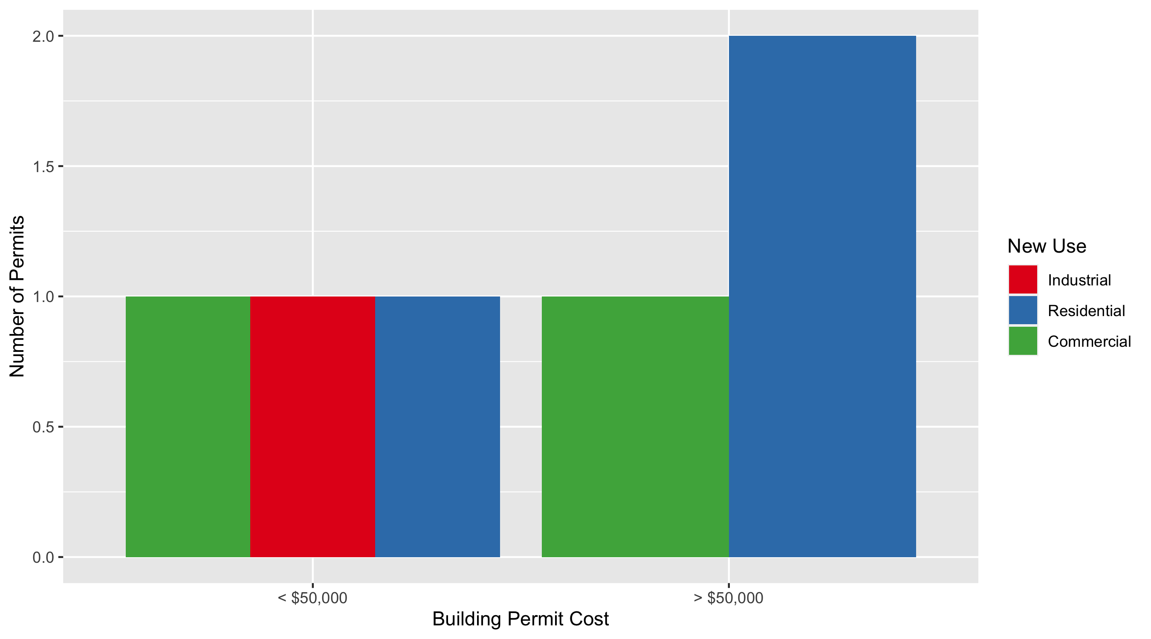
Skinker DeBaliviere Permit Cost Breakdown

Slide 24
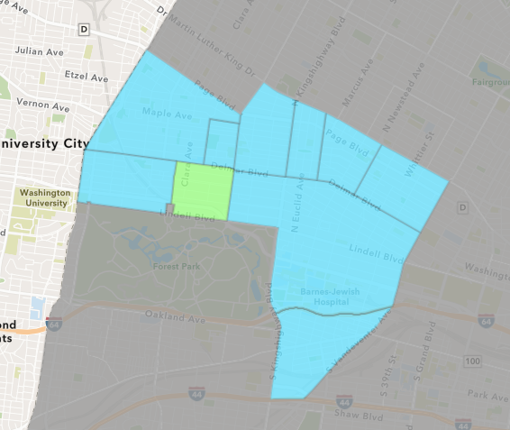
DeBaliviere Place
January 2022 Neighborhood Cost Breakdown
Mean: $32,144
Median: $32,144
Range: $30,000 - $34,289

Slide 25
DeBaliviere Place: Summary Notes
2 building permits in January 2022
-75.00% change compared to January 2021 (8 total building permits)
$32,144: Average building permit cost in January 2022
-60.32% change compared to January 2021 ($81,000)
2 total building permits in 2022
-75.00% change YTD compared to this time in 2021 (8 total building permits)
$32,144: YTD average building permit cost in 2022
-60.32% change YTD compared to this time in 2021 ($81,000)

Slide 26
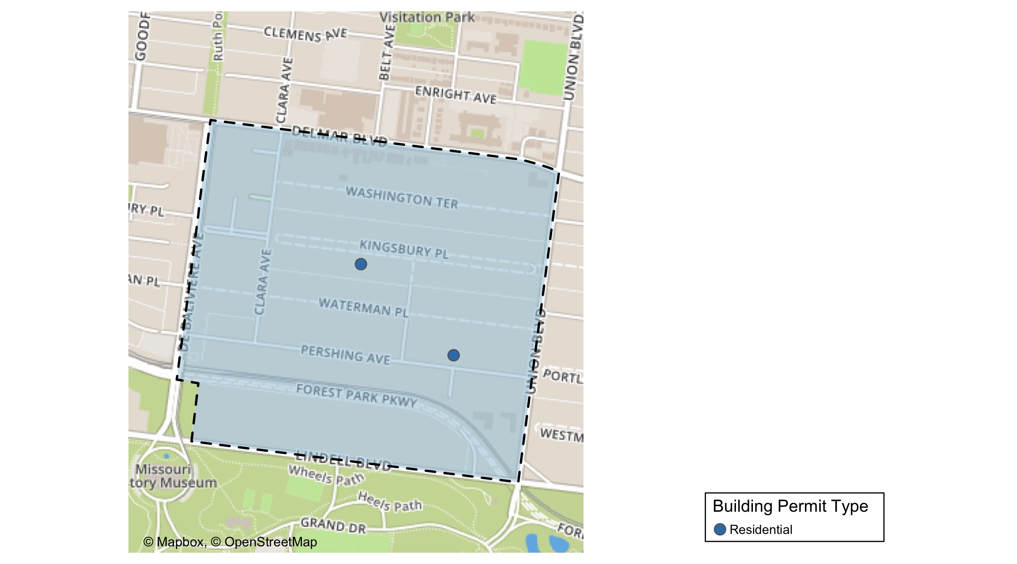
DeBaliviere Place

Slide 27
Neighborhood Summary
January 2022 | January 2022 | January 2022 | January 2022
Permit Use | Average Cost | # of Permits | Total Value of Permits
Commercial | $0.0 | 0 | $0
Industrial | $0.0 | 0 | $0
Residential | $32,144.5 | 2 | $64,289
Last 6 Months | Last 6 Months | Last 6 Months | Last 6 Months
Permit Use | Average Cost | # of Permits | Total Value of Permits
Commercial | $26,250.0 | 2 | $52,500
Industrial | $30,000.0 | 1 | $30,000
Residential | $102,724.2 | 23 | $2,362,657

Slide 28
DeBaliviere Place Individual Permit Breakdown
Neighborhood | Owner | New Use | Cost | address
DeBaliviere Place | CHRISTINE NEIKIRK | Residential | $34,289 | 5367 PERSHING AV
DeBaliviere Place | HUNT-RUDDY, HEATHER A & ROBERT | Residential | $30,000 | 38 KINGSBURY PL

Slide 29
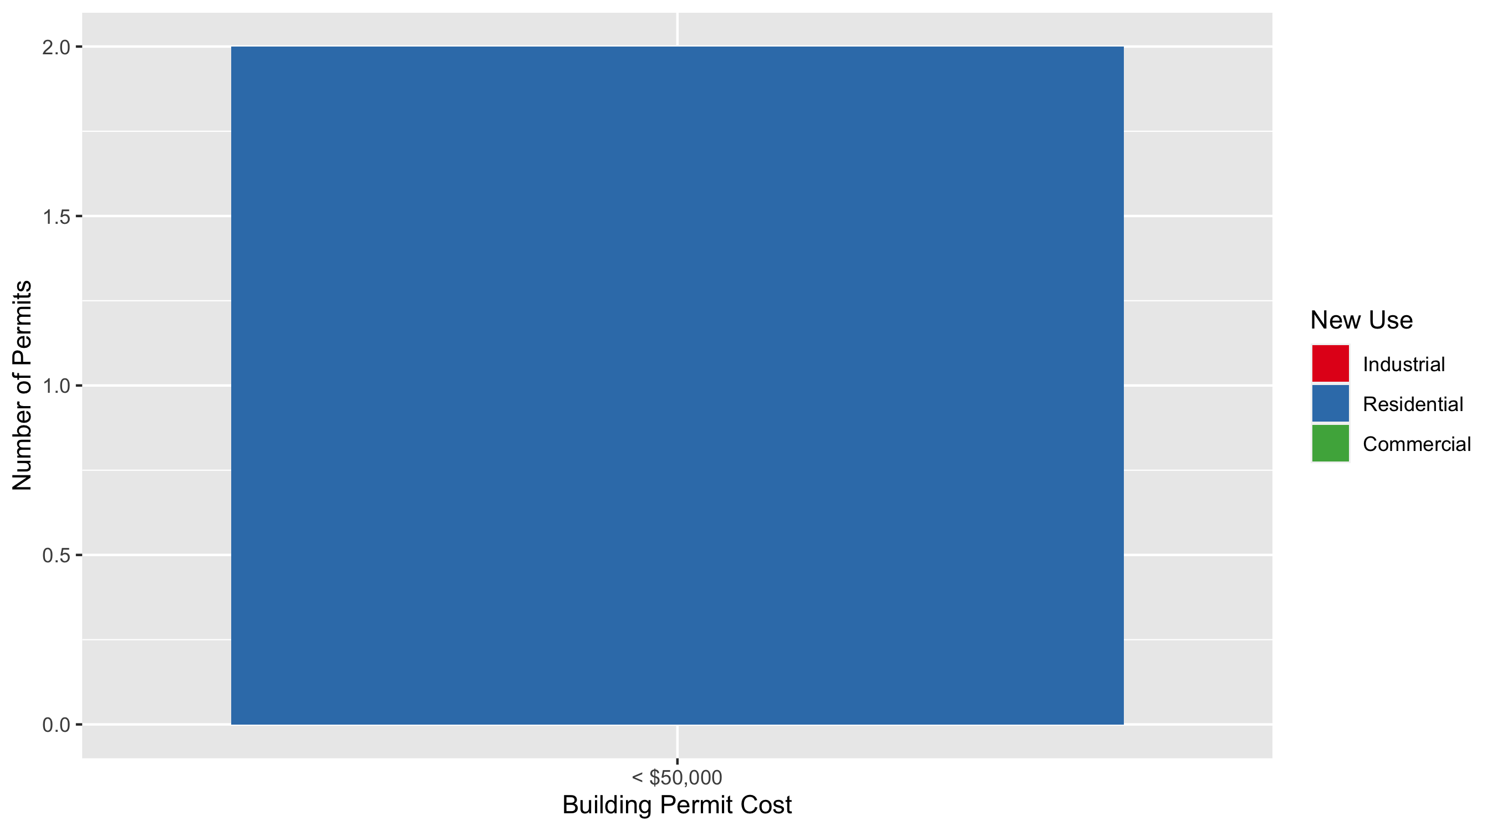
DeBaliviere Place Permit Cost Breakdown

Slide 30
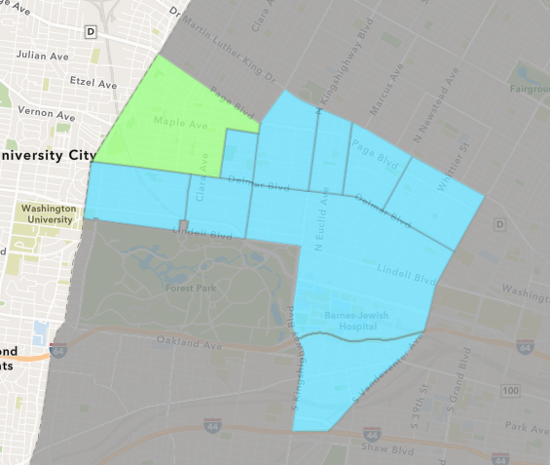
West End
January 2022 Neighborhood Cost Breakdown
Mean: $14,986
Median: $5,566
Range: $2,500 - $50,000

Slide 31
West End: Summary Notes
7 building permits in January 2022
-36.36% change compared to January 2021 (11 total building permits)
$14,986: Average building permit cost in January 2022
-90.32% change compared to January 2021 ($154,794)
7 total building permits in 2022
-36.36% change YTD compared to this time in 2021 (11 total building permits)
$14,986: YTD average building permit cost in 2022
-90.32% change YTD compared to this time in 2021 ($154,794)

Slide 32
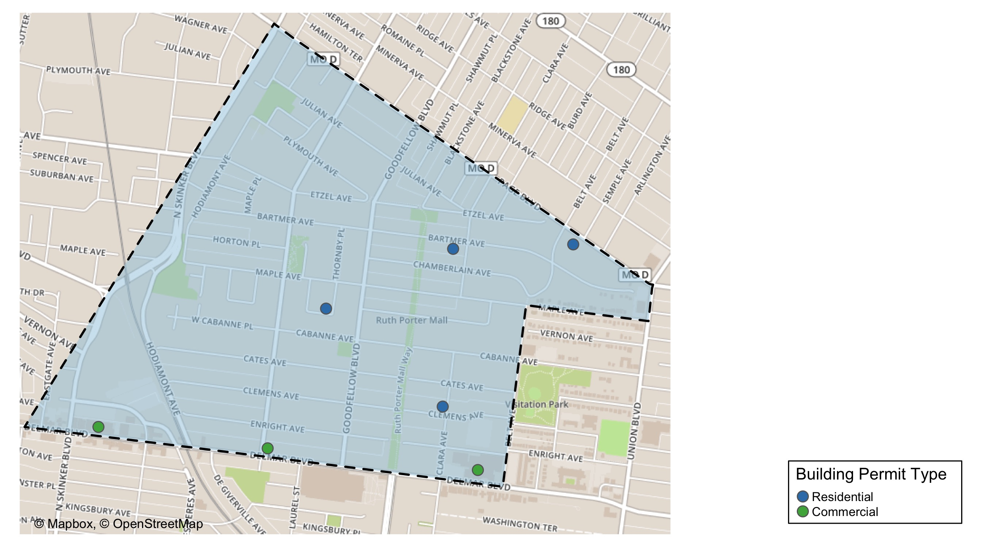
West End

Slide 33
Neighborhood Summary
January 2022 | January 2022 | January 2022 | January 2022
Permit Use | Average Cost | # of Permits | Total Value of Permits
Commercial | $14,677.67 | 3 | $44,033
Industrial | $0.00 | 0 | $0
Residential | $15,216.50 | 4 | $60,866
Last 6 Months | Last 6 Months | Last 6 Months | Last 6 Months
Permit Use | Average Cost | # of Permits | Total Value of Permits
Commercial | $40,855.87 | 38 | $1,552,523
Industrial | $28,487.00 | 3 | $85,461
Residential | $25,737.88 | 41 | $1,055,253

Slide 34
West End Individual Permit Breakdown
Neighborhood | Owner | New Use | Cost | address
West End | HOUSTON, CARVELL K JR | Residential | $50,000 | 935 LAUREL ST
West End | WESTEND DEVELOPMENT LLC | Commercial | $5,600 | 5897 DELMAR BLVD
West End | C5603 LP | Residential | $5,566 | 807 CLARA AV
West End | MONTANO, GLORIA | Commercial | $5,500 | 6163 DELMAR BLVD
West End | DELMAR DIVINE CONDO | Commercial | $32,933 | 5535 DELMAR BLVD
West End | COOPER, MANTON L | Residential | $2,500 | 5616 BARTMER AV
West End | NOBLES, PAUL & ROSE LISA | Residential | $2,800 | 5442 PAGE BLVD

Slide 35
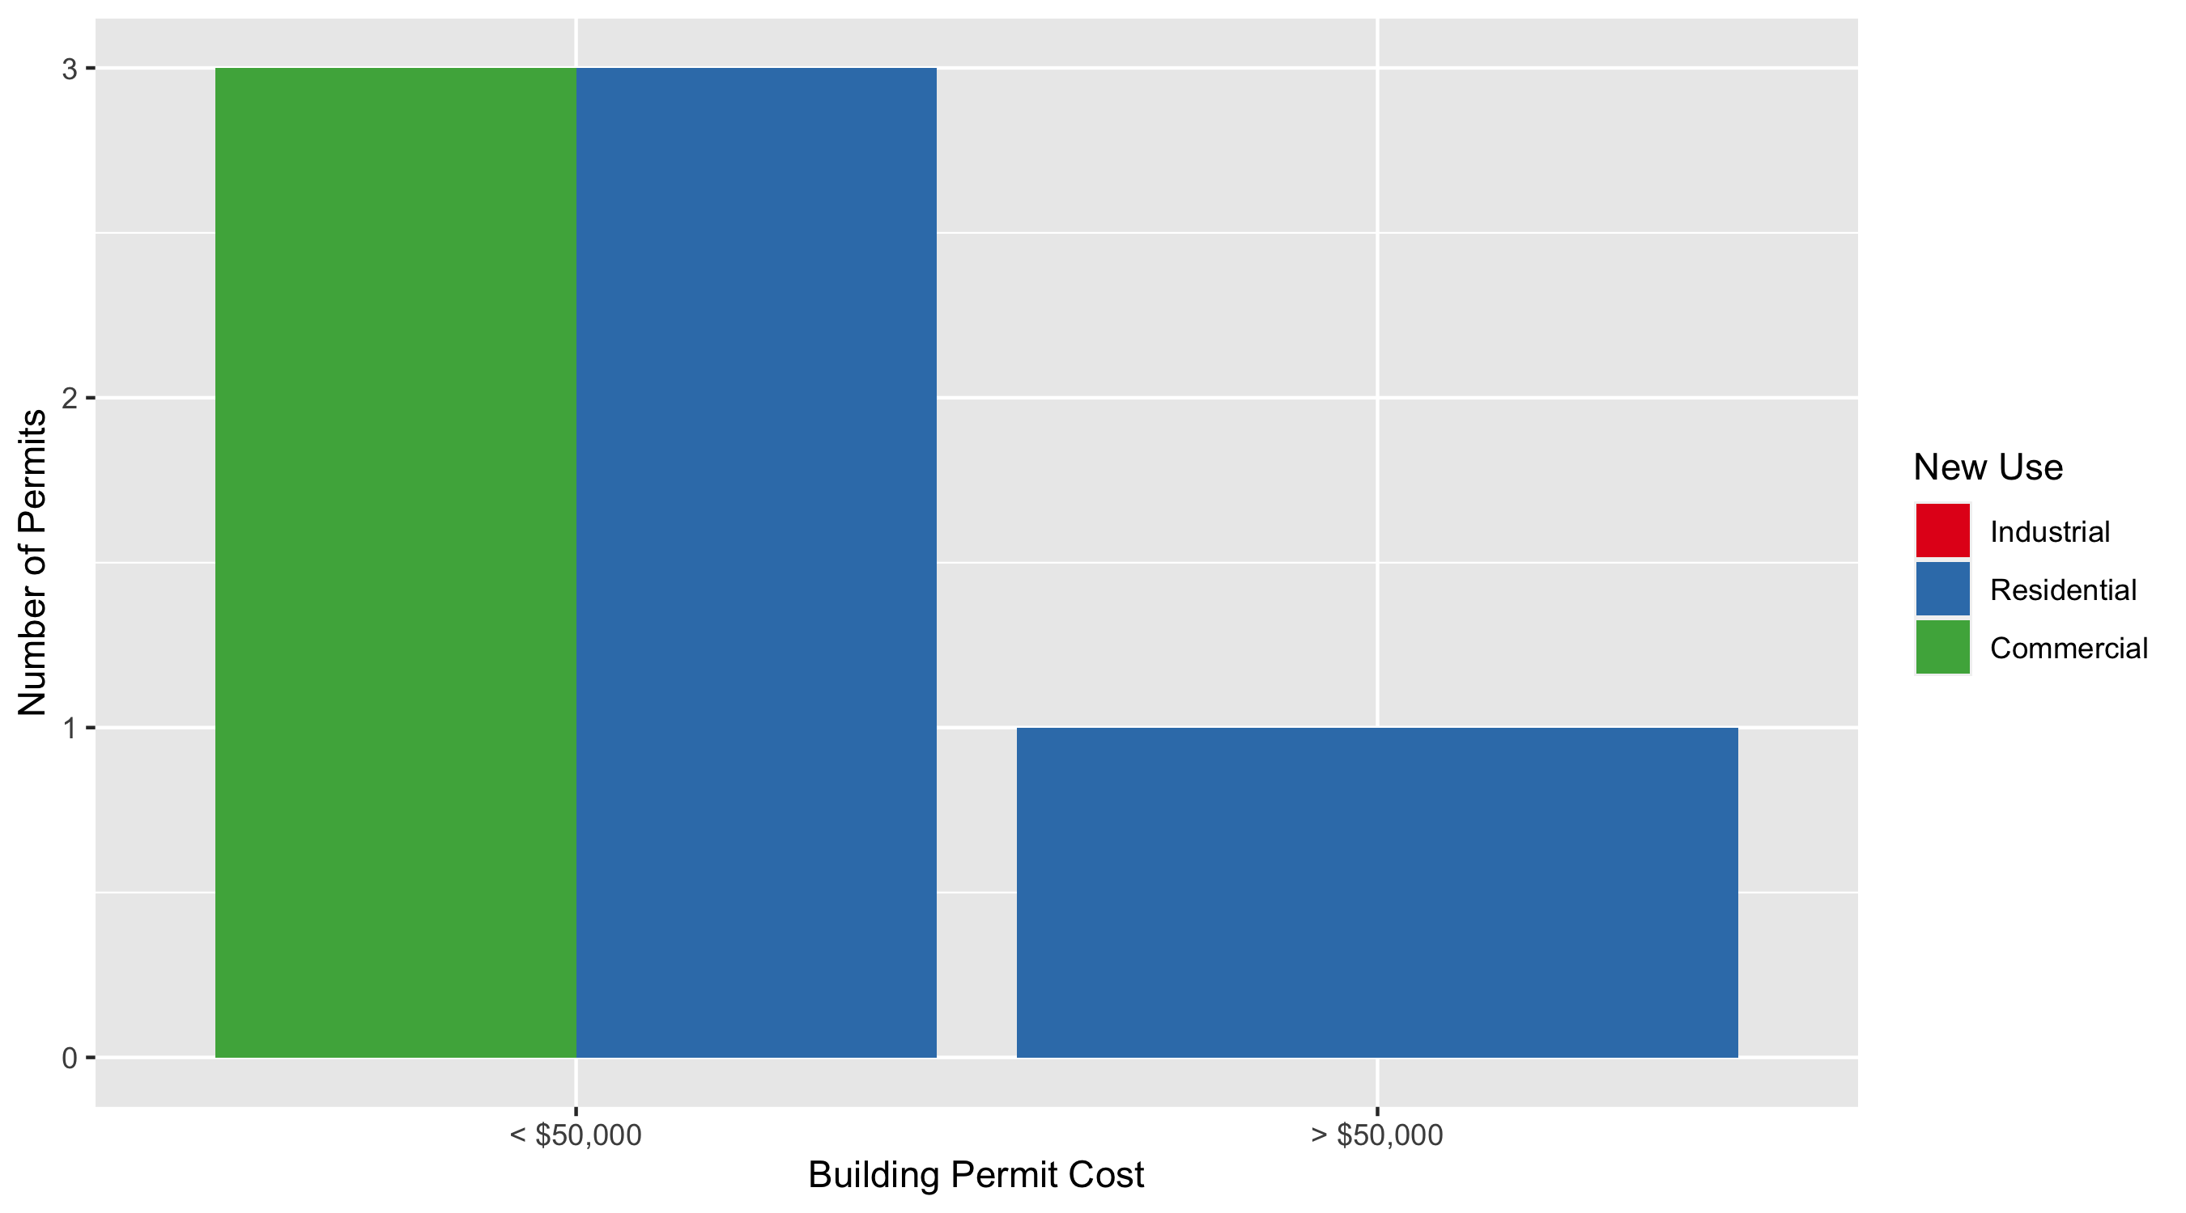
West End Permit Cost Breakdown

Slide 36
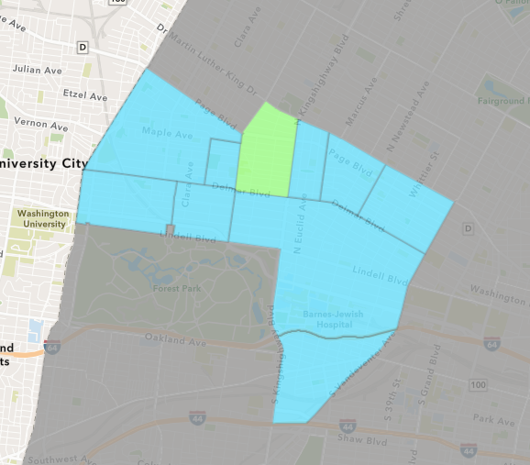
Academy
January 2022 Neighborhood Cost Breakdown
Mean: $157,100
Median: $157,100
Range: $100,000 - $214,200

Slide 37
Academy: Summary Notes
2 building permits in January 2022
0.00% change compared to January 2021 (2 total building permits)
$157,100: Average building permit cost in January 2022
6480.10% change compared to January 2021 ($2,388)
2 total building permits in 2022
0.00% change YTD compared to this time in 2021 (2 total building permits)
$157,100: YTD average building permit cost in 2022
6480.10% change YTD compared to this time in 2021 ($2,388)

Slide 38
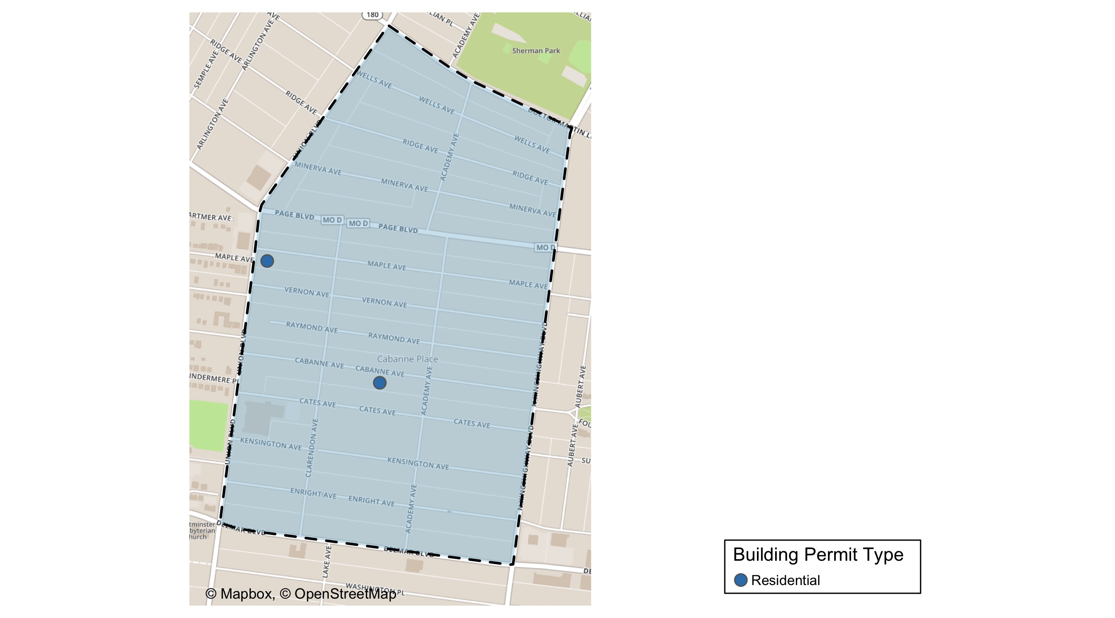
Academy

Slide 39
Neighborhood Summary
January 2022 | January 2022 | January 2022 | January 2022
Permit Use | Average Cost | # of Permits | Total Value of Permits
Commercial | $0 | 0 | $0
Industrial | $0 | 0 | $0
Residential | $157,100 | 2 | $314,200
Last 6 Months | Last 6 Months | Last 6 Months | Last 6 Months
Permit Use | Average Cost | # of Permits | Total Value of Permits
Commercial | $104,060 | 5 | $520,300
Industrial | $950 | 3 | $2,850
Residential | $34,451 | 18 | $620,118

Slide 40
Academy Individual Permit Breakdown
Neighborhood | Owner | New Use | Cost | address
Academy | 5262 MAPLE LLC | Residential | $214,200 | 5262 MAPLE AV
Academy | GA CAPITAL LLC | Residential | $100,000 | 5142 CABANNE AV

Slide 41

Academy Permit Cost Breakdown

Slide 42
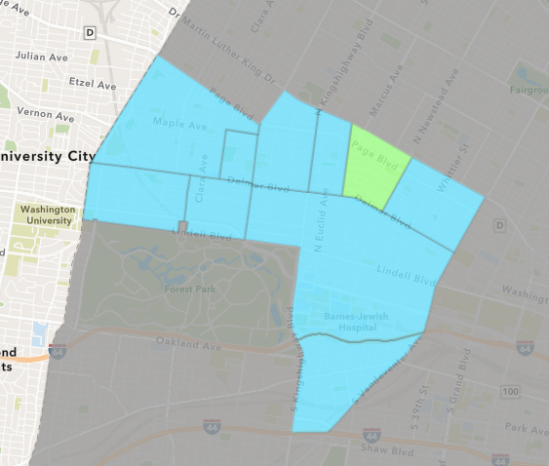
Lewis Place
January 2022 Neighborhood Cost Breakdown
Mean: $7,500
Median: $7,500
Range: $7,500 - $7,500

Slide 43
Lewis Place: Summary Notes
1 building permits in January 2022
-50.00% change compared to January 2021 (2 total building permits)
$7,500: Average building permit cost in January 2022
7.74% change compared to January 2021 ($6,962)
1 total building permits in 2022
-50.00% change YTD compared to this time in 2021 (2 total building permits)
$7,500: YTD average building permit cost in 2022
7.74% change YTD compared to this time in 2021 ($6,962)

Slide 44
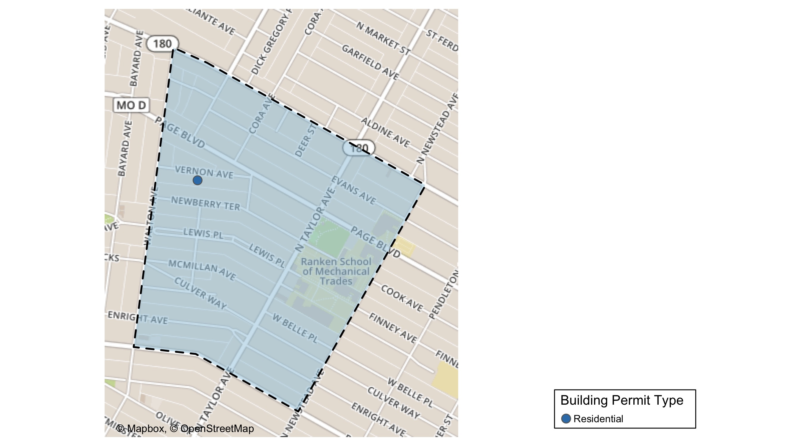
Lewis Place

Slide 45
Neighborhood Summary
January 2022 | January 2022 | January 2022 | January 2022
Permit Use | Average Cost | # of Permits | Total Value of Permits
Commercial | $0 | 0 | $0
Industrial | $0 | 0 | $0
Residential | $7,500 | 1 | $7,500
Last 6 Months | Last 6 Months | Last 6 Months | Last 6 Months
Permit Use | Average Cost | # of Permits | Total Value of Permits
Commercial | $279,084 | 4 | $1,116,336
Industrial | $20,000 | 3 | $60,000
Residential | $32,175 | 8 | $257,400

Slide 46
Lewis Place Individual Permit Breakdown
Neighborhood | Owner | New Use | Cost | address
Lewis Place | THOMAS, KEITH, MARVIN THOMAS, TEVEN | Residential | $7,500 | 4708 VERNON AV

Slide 47
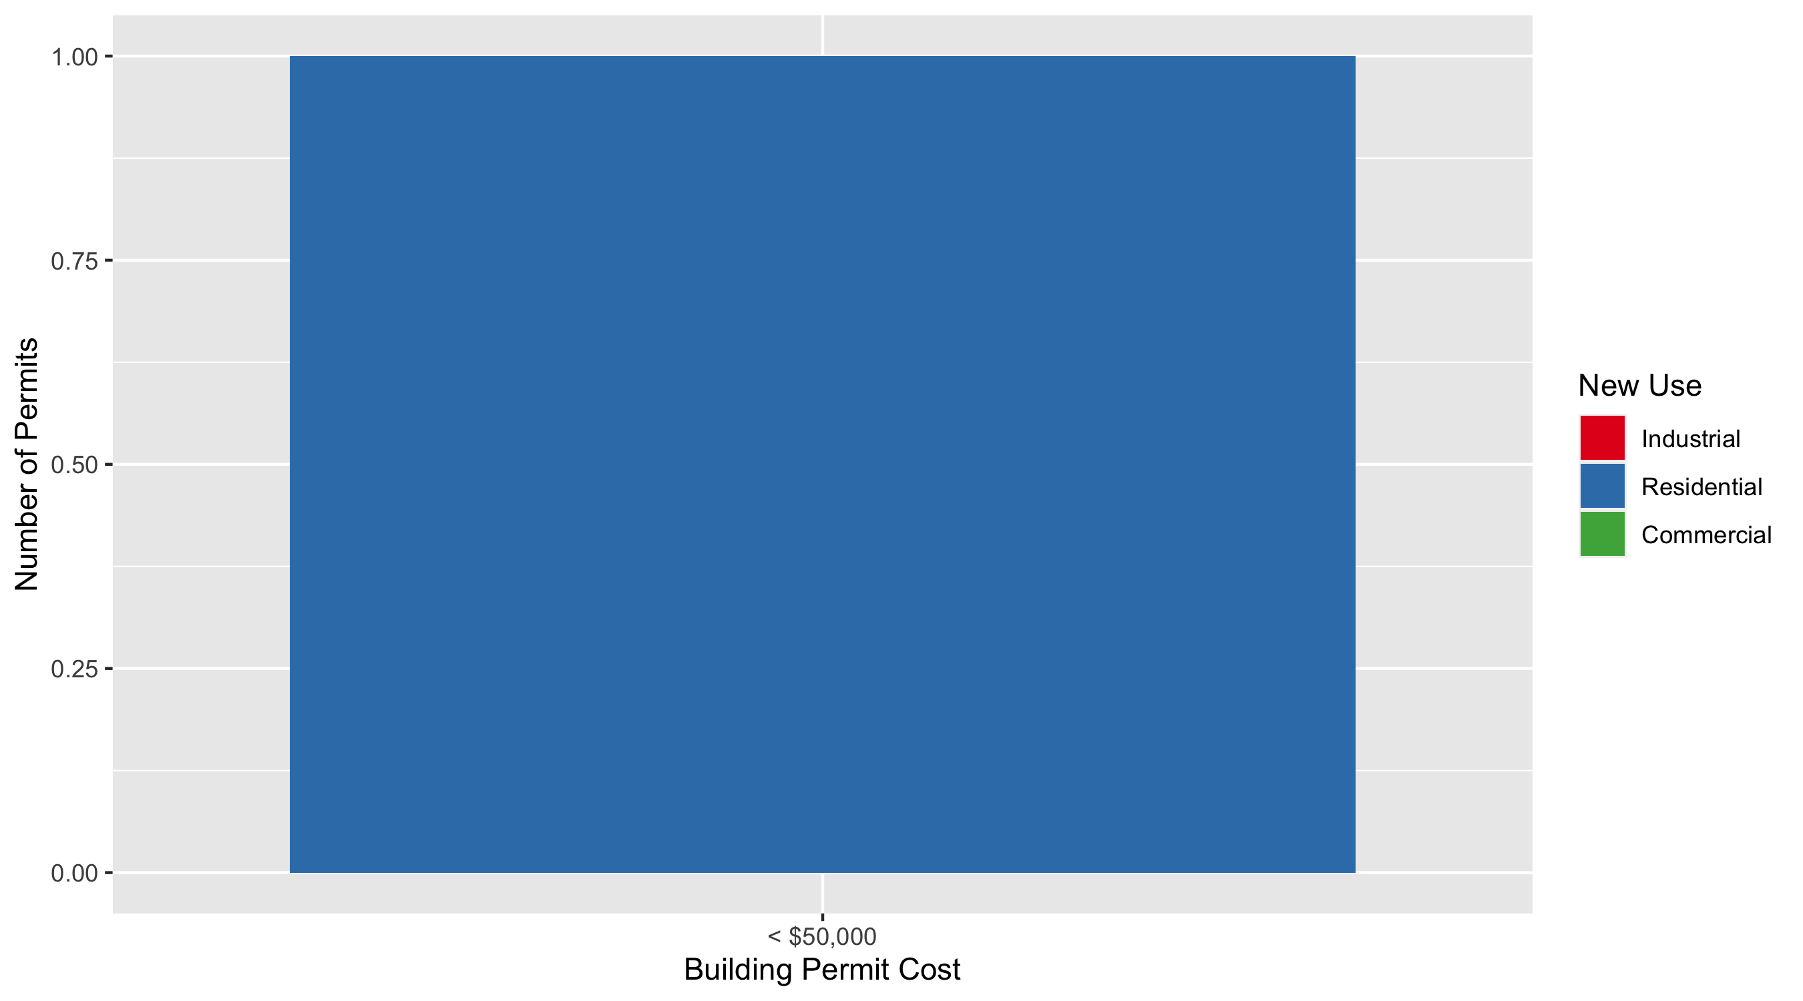
Lewis Place Permit Cost Breakdown

Slide 48
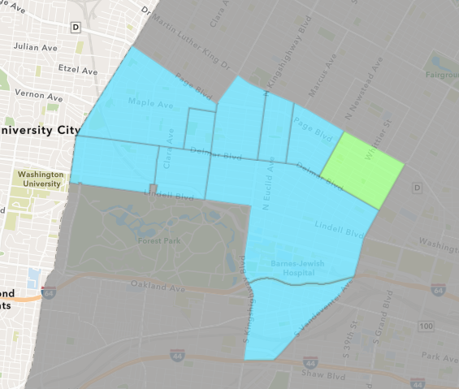
Vandeventer
January 2022 Neighborhood Cost Breakdown
Mean: $124,000
Median: $124,000
Range: $124,000 - $124,000

Slide 49
Vandeventer: Summary Notes
1 building permits in January 2022
Infinite change compared to January 2021 (0 total building permits)
$124,000: Average building permit cost in January 2022
Infinite change compared to January 2021 ($0)
1 total building permits in 2022
Infinite change YTD compared to this time in 2021 (0 total building permits)
$124,000: YTD average building permit cost in 2022
Infinite change YTD compared to this time in 2021 ($0)

Slide 50
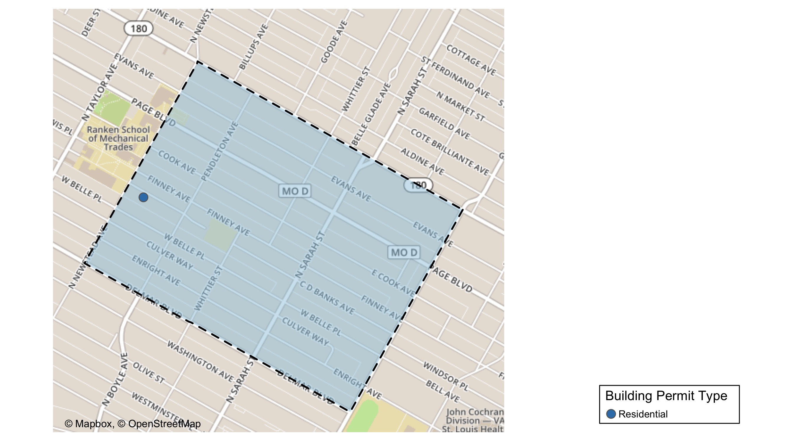
Vandeventer

Slide 51
Neighborhood Summary
January 2022 | January 2022 | January 2022 | January 2022
Permit Use | Average Cost | # of Permits | Total Value of Permits
Commercial | $0 | 0 | $0
Industrial | $0 | 0 | $0
Residential | $124,000 | 1 | $124,000
Last 6 Months | Last 6 Months | Last 6 Months | Last 6 Months
Permit Use | Average Cost | # of Permits | Total Value of Permits
Commercial | $0.000 | 0 | $0
Industrial | $4,266.667 | 3 | $12,800
Residential | $121,995.667 | 12 | $1,463,948

Slide 52
Vandeventer Individual Permit Breakdown
Neighborhood | Owner | New Use | Cost | address
Vandeventer | HAYLES, WILLIAM III & CAROL R | Residential | $124,000 | 4357 W FAIRFAX CT

Slide 53

Vandeventer Permit Cost Breakdown

Slide 54
Additional Notes
Data retreived from https://www.stlouis-mo.gov/data/
Building permits with a cost of $0 were dropped
Building permits that were cancelled were dropped
Infinite change indicates 0 permits in the current or previous time period/comparison month so there was a overall increase or decrease

